Slide 1
NATCO PHARMA LIMITED
INVESTOR PRESENTATION
Q1 2021-22

Slide 2
DISCLAIMER/IMPORTANT DISCLOSURE
THIS PRESENTATION (PRESENTATION) IS NOT AN OFFER TO SELL ANY SECURITIES OR A SOLICITATION TO BUY ANY SECURITIES OF NATCO PHARMA LIMITED OR ITS SUBSIDIARIES OR JOINT VENTURES (TOGETHER, THE “COMPANY”).
The material that follows is a Presentation of general background information about the Company’s activities as at the date of the Presentation or as otherwise indicated. It is information given in summary form and does not purport to be complete and it cannot be guaranteed that such information is true and accurate. This Presentation has been prepared by and is the sole responsibility of the Company. By accessing this Presentation, you are agreeing to be bound by the trading restrictions. It is for general information purposes only and should not be considered as a recommendation that any investor should subscribe / purchase the Company shares.
This Presentation includes statements that are, or may be deemed to be, “forward-looking statements”. These forward-looking statements can be identified by the use of forward- looking terminology, including the terms “believes”, “estimates”, “anticipates”, “projects”, “expects”, “intends”, “may”, “will”, “seeks” or “should” or, in each case, their negative or other variations or comparable terminology, or by discussions of strategy, plans, aims, objectives, goals, future events or intentions. These forward-looking statements include all matters that are not historical facts. They appear in a number of places throughout this Presentation and include statements regarding the Company’s intentions, beliefs or current expectations concerning, amongst other things, its results or operations, financial condition, liquidity, prospects, growth, strategies and the industry in which the Company operates.
By their nature, forward-looking statements involve risks and uncertainties because they relate to events and depend on circumstances that may or may not occur in the future. Forward-looking statements are not guarantees of future performance including those relating to general business plans and strategy of the Company, its future outlook and growth prospects, and future developments in its businesses and its competitive and regulatory environment. No representation, warranty or undertaking, express or implied, is made or assurance given that such statements, views, projections or forecasts, if any, are correct or that the objectives of the Company will be achieved. There are some important factors that could cause material differences to Company’s actual results. These include (i) our ability to successfully implement our strategy (ii) our growth and expansion plans (iii) changes in regulatory norms applicable to the Company (iv) technological changes (v) investment and business income (vi) cash flow projections etc. (vii) exposure to market as well as other risks.
The Company, as such, makes no representation or warranty, express or implied, as to, and does not accept any responsibility or liability with respect to, the fairness, accuracy, completeness or correctness of any information or opinions contained herein. The information contained in this Presentation, unless otherwise specified is only current as of the date of this Presentation. The Company assumes no responsibility to publicly amend, modify or revise any forward looking statements, on the basis of any subsequent development, information or events, or otherwise. Unless otherwise stated in this Presentation, the information contained herein is based on management information and estimates.
Any opinions expressed in this presentation are subject to change without notice. The presentation should not be construed as legal, tax, investment or other advice. None of the Company or any of its affiliates, advisers or representatives accepts any liability whatsoever for any loss howsoever arising from any information presented or contained in this presentation. The information contained in this presentation has not been independently verified. Furthermore, no person is authorized to give any information or make any representation which is not contained in, or is inconsistent with, this presentation. Any such extraneous or inconsistent information or representation, if given or made, should not be relied upon as having been authorized by or on behalf of the Company. Further, past performance is not necessarily indicative of future results.
This document is just a Presentation for information purposes and private circulation only and is not intended to be a “prospectus” or “offer document” or a “private placement offer letter” (as defined or referred to, as the case may be, under the Companies Act, 2013). It is clarified that this Presentation is not intended to be a document offering for subscription or sale of any securities or inviting offers from the Indian public (including any section thereof) or from persons residing in any other jurisdiction including the United States for the subscription to or sale of any securities including the equity shares of the Company or any of its subsidiaries. No part of it should form the basis of or be relied upon in connection with any investment decision or any contract or commitment to purchase or subscribe for any securities. None of the Company’s securities may be offered or sold in the United States without registration under the U.S. Securities Act of 1933, as amended, except pursuant to an exemption from registration there from.
This document has not been and will not be reviewed or approved by a regulatory authority in India or by any stock exchange in India. This presentation is confidential and this presentation or any part thereof should not be used or relied upon by any other party or for any other purpose and should not be copied, reproduced, recirculated, redistributed, published in any media, website or otherwise, in any form or manner, in part or as a whole, without the express consent in writing of the Company. Any unauthorized use, disclosure or public dissemination of information contained herein is prohibited. The distribution of this presentation in certain jurisdictions may be restricted by law. Accordingly, any persons in possession of the aforesaid should inform themselves about and observe any such restrictions.

Slide 3
BUSINESS OVERVIEW
Vertically integrated pharmaceutical company with presence across geographies - India, US and ROW
Strong brand position in domestic pharma segments
- Well established player in oncology with brands catering to diseases including breast, bone, lung and ovarian cancer
- Growing presence in Cardio and Diabetes products
Focused on complex generics for the US Markets with niche Para IV and Para III filings
Two R&D centers with over 525 employees ⁽¹⁾
Poised for growth in the agrichemical space with launch of high potential products
Total revenues⁽²⁾ of INR 21,557 million for the financial year ended 31st March 2021
Listed on BSE and NSE with a market capitalization ⁽³⁾ of USD 2.8 billion
Incorporated in 1981 and headquartered in Hyderabad with around 5,000 employees across all locations ⁽¹⁾
(1) As of March 31, 2021
(2) Represents consolidated gross revenue and includes other income
(3) Market capitalization as of June 30, 2021 using INR / USD exchange rate of ₹ 74.3456

Slide 4
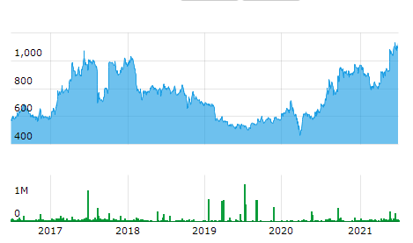
PERFORMANCE AT A GLANCE
Ownership Structure⁽³⁾
Natco Pharma’s Stock Performance over the years⁽⁴⁾
FY numbers have been prepared under Ind AS
Represents consolidated gross revenue and includes other income
Represents PAT after minority interest
(3) Data as on June 30, 2021
(4) As on June 30, 2021 closing

Slide 5
KEY BUSINESS SEGMENTS - PHARMA
 | FORMULATIONS
 | Domestic | International Exports | API (Domestic & Exports) | Subsidiaries
Overview⁽¹⁾ | Three key business segments: Oncology, Specialty Pharma, Cardiology and Diabetology Strong brand position in the domestic oncology Launched strong portfolio of products in the Cardiology and Diabetology segments Specialist sales force of nearly 400 personnel and over 500 distributors Targeting 6-8 product launches a year with over 15% growth Consolidation of Hepatitis-B and Hepatitis-C portfolios through hepatologists and gastroenterologists in India Strengthening the neurology portfolio | Focused on niche opportunities in the US Front end partnerships with leading global generic pharma companies Focus on Para IV and First-to-File molecules Strengthening presence in Asia and other ROW markets by registering our niche product portfolio in these countries Filed 6 products with regulatory authorities for China market Started winning tenders in Asian markets including Malaysia and Thailand | Strategically important division 39 active DMFs in the US with niche products under development Exports focused on US, Europe and emerging markets Oncology APIs and specialty products Attempting difficult-to-make chemistry with long synthesis Expanding our oligo-nucleotide portfolio | Operations in Brazil, Canada, Singapore, Australia and Philippines In Canada, strong portfolio with 25+ products including Oncology, cardiovascular and CNS therapies In Brazil, we continue to file high-potential products with a target portfolio of 6+ in the near term. Natco launched Oseltamivir as the sole generic Building a strong product portfolio in Singapore in both Tender and Private segments 10+ product approvals in Singapore
FY 2020 Revenue (₹ mn) | 5,405 | 8,249 | 3,552 | 1,085
FY 2021 Revenue (₹ mn) ⁽²⁾ | 4,101 | 6,760 | 5,120 | 4,011
FY 2021 Revenue Composition | 19% | 31% | 24% | 19%
As of March 31, 2021​
Balance operating and non-operating income = INR 1565 million (7%)

Slide 6
US MARKET- FOCUS ON COMPLEX GENERICS
KEY PRODUCTS IN THE PORTFOLIO
STRATEGY FOR US MARKETS
Predominantly focused on high-barrier-to-entry products that are typically characterized by one or more of the following
Intricate Chemistry
Challenging delivery systems
Difficult or complex manufacturing process
Low risk business model; through partnerships with global pharmaceutical players
Marketing partner typically responsible for litigation and regulatory process to secure ANDA approval.
Multi-site approvals
Multi-sourcing arrangements
Profit sharing arrangements with front-end partners
Current Portfolio | Key Brand​ | Molecule​ | Therapeutic Segment / Primary Indication​
 | Copaxone​ | Glatiramer Acetate​ | CNS/Multiple Sclerosis​
 | Tamiflu​ | Oseltamivir​ | Anti-Viral/Influenza​
 | Afinitor(2.5 mg, 5 mg and 7.5 mg) | Everolimus (higher strength)​ | Cancer/Breast​
 | Fosrenol​ | Lanthanum Carbonate​ | Renal disease​
 | Doxil​ | Liposomal Doxorubicin ​ | Cancer/ Ovarian and other​
 | Tykerb​ | Lapatinib Ditosylate​ | Cancer/Breast​
KEY PARA IV PRODUCTS IN THE PIPELINE
To Be Launched | Key Brand​ | Molecule​ | Therapeutic Segment / Primary Indication
 | Nexavar​ | Sorafenib​ | Cancer/Kidney & Liver​
 | Revlimid​ | Lenalidomide​ | Cancer/Multiple Myeloma​
 | Afinitor​ (10 mg) | Everolimus (higher strength)​ | Cancer/Breast​
 | Zortess​ | Everolimus (lower strength)​ | ImmuneSupression/OrganTransplant​
 | ​Aubagio​ | Teriflunomide​ | CNS/Multiple Sclerosis​
 | Kyprolis​ | Carfilzomib​ | Cancer/Multiple Myeloma​
 | Pomalyst​ | Pomalidomide​ | Cancer/Multiple Myeloma​
 | Sovaldi​ | Sofosbuvir​ | Anti-Viral / Hep C​
 | Ibruvica ​ | Ibrutinib ​ | Cancer/Leukaemia ​
 | Lonsurf​ | Trifluridine/Tipracil​ | Metastatic colorectal cancer ​
 | TracleerTFOS​ | Bosentan​ | Pulmonary Arterial Hypertension​
PIPELINE OF NICHE AND ACTIVE PRODUCTS IN THE US
Active and Pipeline products
- 25 active commercial products
19 Para IVs in the pipeline of which 12 are approved ⁽¹⁾
As of March 31, 2021. Approval received either by Natco or its marketing partner

Slide 7
STRONG GROWTH IN DOMESTIC BUSINESS
DOMESTIC PRODUCT LAUNCHES IN FY 2021
DOMESTIC FORMULATION SALES⁽¹⁾ ₹ mn
Launched 10 products during the year
Leading player in branded oncology medicines in India
Market leading positions across the Hep-C class of drugs in India, in spite of market size reduction
In the speciality pharma space, focused on improving the anti-infective therapy area to strengthen the product range
Continue to focus and attempt launches of niche molecules with high barriers to entry. Expect unlocking of value in near future with existing and other molecules in the pipeline
10+ Brands in #1 position in indicated prescription
Around 400
Sales force in India
9
Brands in excess of INR 100mn+ sales
STRONG POSITION IN
ONCOLOGY AND
HEPATITIS-C DOMAINS
FY 21 saw significant pressure in Oncology sales due to the pandemic and patients staying away from the hospitals. The Company expects to see a rebound in the domestic revenues in the coming years
FY numbers have been prepared under Ind AS
(1) Represents gross revenue

Slide 8
STRONG MARKET POSITION IN DOMESTIC ONCOLOGY SEGMENT
OVERVIEW OF ONCOLOGY DIVISION
ONCOLOGY REVENUE ₹ mn
18 years of strong presence in oncology segment. One of the leaders in the sale of branded oncology medicines in India
Portfolio of well recognized brands – 7 brands with INR 100mn+ sales in the oncology segment
Widened its oncology product range from 6 in 2003-04 to 38⁽¹⁾ in 2020-21
Sales and marketing of the product is supported by around 100 sales representatives and strategically located logistics network of distributors
Aggressive introduction of novel drugs in cancer
ONCOLOGY PORTFOLIO
NUMBER OF
ACTIVE
BRANDS – 38
INR – 100 Mn+ brands
Veenat
Lenalid
Carfilnat
Geftinat
Erlonat
Sorafenat
Ibrunat
HEMATOLOGY
16
SOLID TUMOURS
22
FY numbers have been prepared under Ind AS
As on March 31, 2021

Slide 9
EXPANDING ROW PRESENCE
CANADA
Strong portfolio with 25+ products including Oncology, cardiovascular
and CNS therapies
22 approvals in place
Launched Nat-Lanthanum as the sole generic in the market
SUBSIDIARIES PERFORMANCE ₹ mn
BRAZIL
Launched the first generic of Oseltamivir in Brazil
Further evolution of market share of sole generic of Everolimus
Transition to the new QC lab and warehouse at Vitoria, Brazil
PHILIPPINES
Liposomal Doxorubicin approved and first Natco product to be launched by our subsidiary Natco Lifesciences Philippines Inc
ASIA PACIFIC (including Australia)
Presence in Singapore (10 approvals) and Australia
*
Natco has 7 subsidiaries including one step-down subsidiary. Majority of growth in FY 21 was generated from Canadian subsidiary

Slide 10
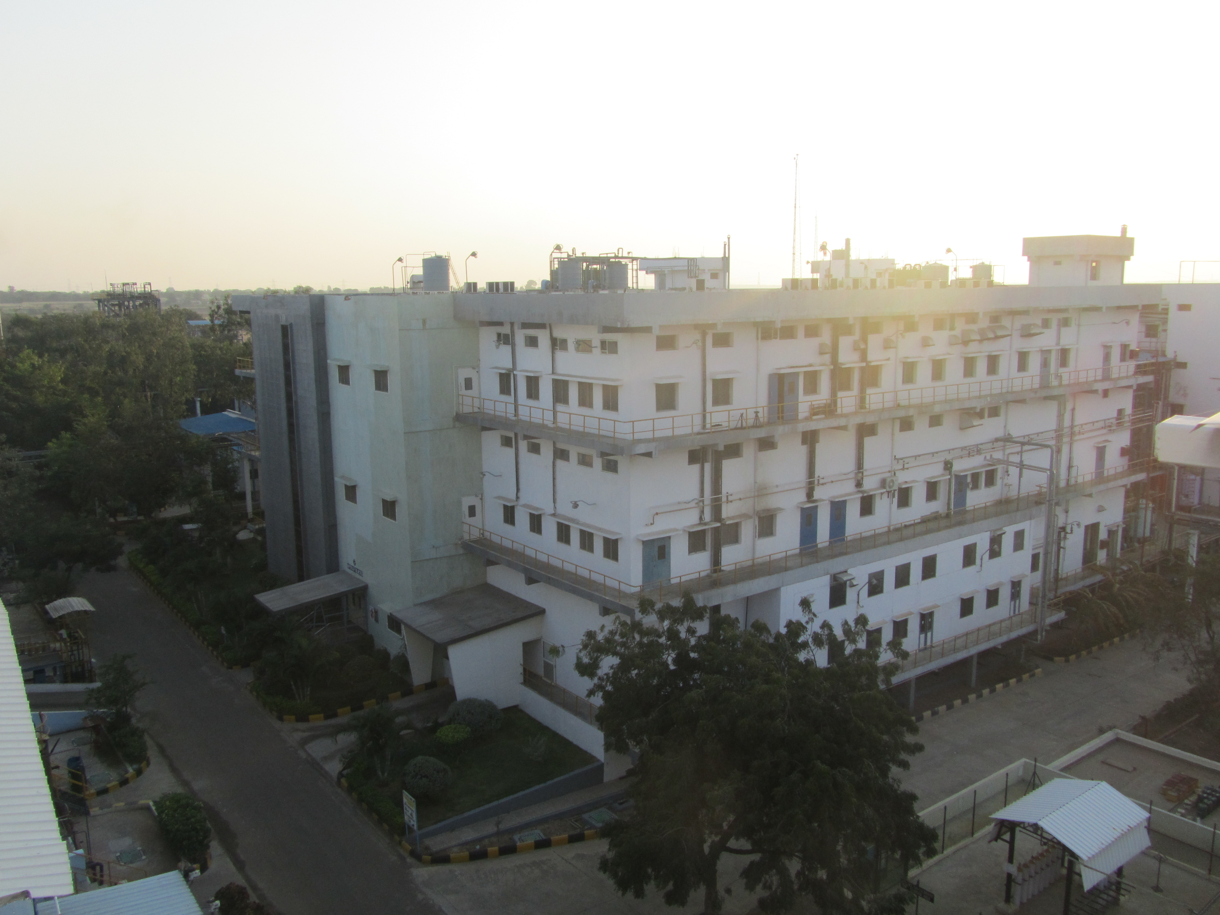
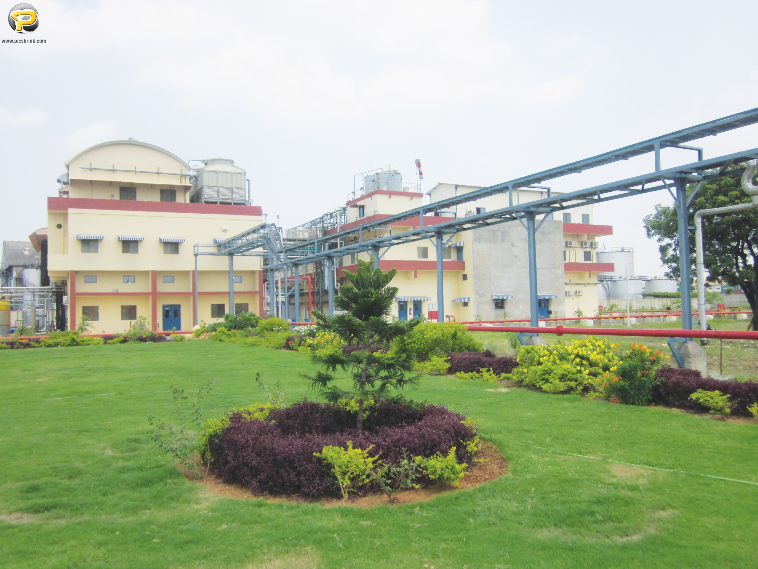
API FACILITIES
Strategically important business – develops APIs primarily for third party sales and also for captive consumption
Portfolio of 39 active US DMFs with niche products under development
Focuses on complex molecules in oncology and CNS segments.
Other therapeutic areas of focus includes Anti-asthmatic, Anti-depressant, Anti-migraine, Anti-osteoporosis and G I Disorders
Exports are focused on the US, EU, Latin America and RoW markets.
Vertical integration for several APIs a key competitive advantage
STRENGTHS
Well established process safety engineering lab
Complex multi-step synthesis & scale-up
Advanced synthetic/separation technologies
Containment facility for handling High potency APIs
Peptide (Solid phase) pharmaceuticals
Oligo nucleotide Pharmaceuticals
Well established NCEs screening (including Zebra fish) facility
MEKAGUDA, TELANGANA
CHENNAI, TAMIL NADU
Oncology API's and speciality products
Approvals from USFDA, PMDA (Japan), COFEPRIS (Mexico), EDQM (Europe), Korean FDA, WHO, EU GMP (Germany)
Last USFDA audit successfully completed and EIR received in September 2019
Cytotoxic API’s
Synthetic chemistry
WHO GMP (CDSCO), USFDA
USFDA audit with Establishment Inspection Report (EIR) received in July 2019

Slide 11
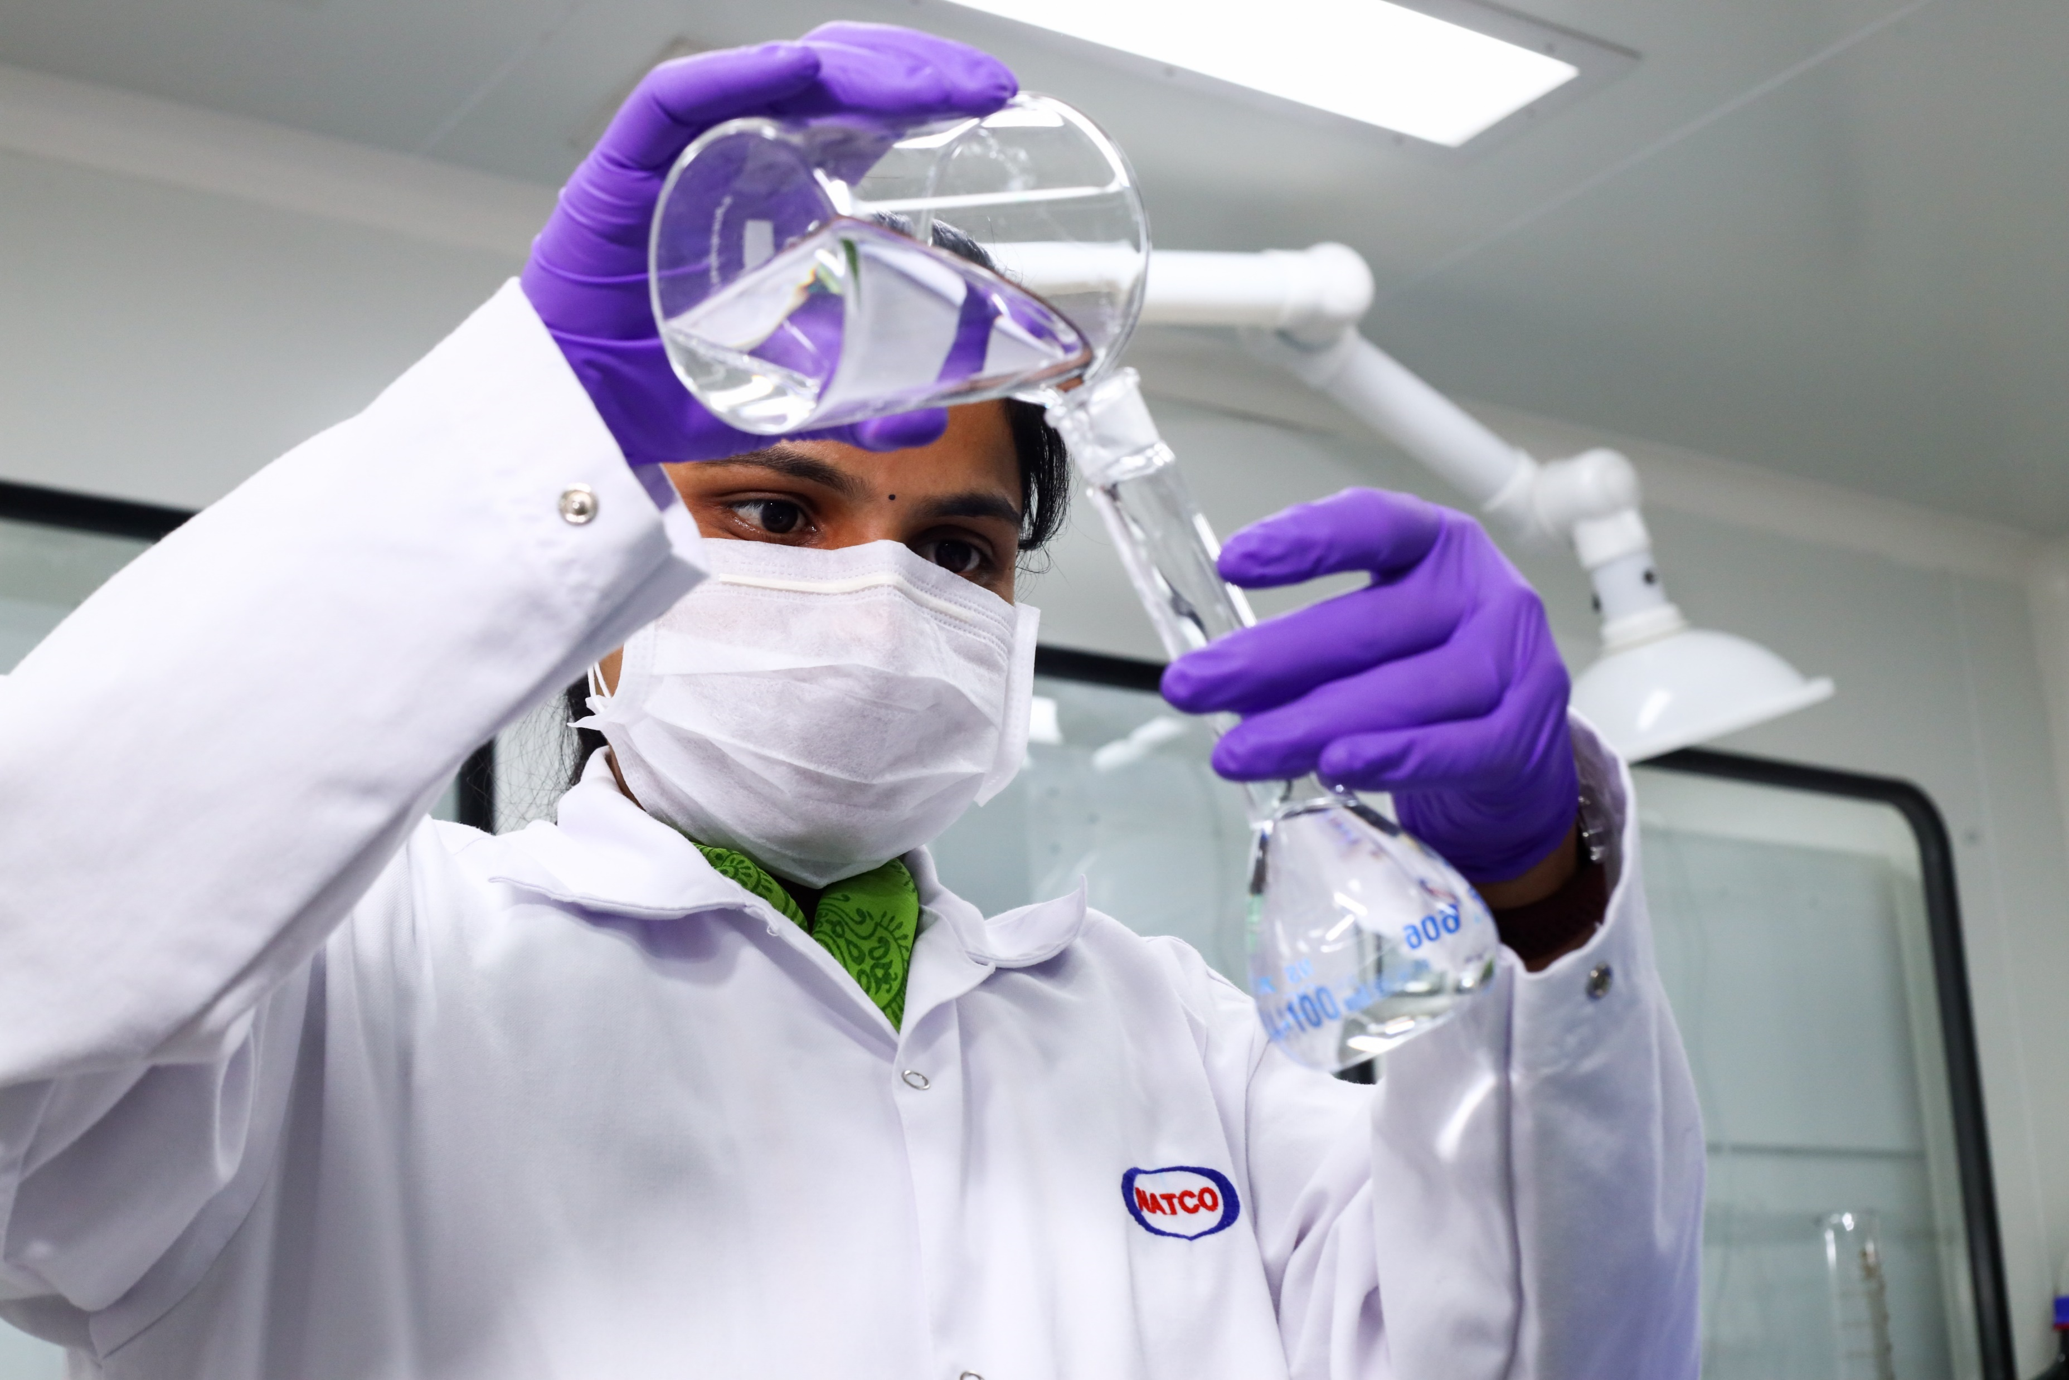
RESEARCH & DEVELOPMENT CAPABILITIES
R&D capabilities demonstrated by its complex and niche product filings in formulations and API segments
Two research facilities with capabilities across synthetic chemistry, nano pharmaceuticals, new drug discovery and
cell biology
FINISHED DOSAGE FORMULATIONS (FDF)⁽²⁾
- 25 commercial​ products
- 19 Para IV ANDAs in pipeline​
ACTIVE PHARMACEUTICAL INGREDIENTS​ (API)
- 49 Cumulative DMFs filed​
- 39 active DMFs⁽²⁾
R&D Expense (₹ mn)
Talented Pool of Scientists (Total no: 534)⁽¹⁾
Over 40 R&D laboratories in 2 research facilities
FY numbers have been prepared under Ind AS
As of March 31, 2021 (2) As of March 31, 2021. Does not include integrated DMFs filed with ANDAs

Slide 12
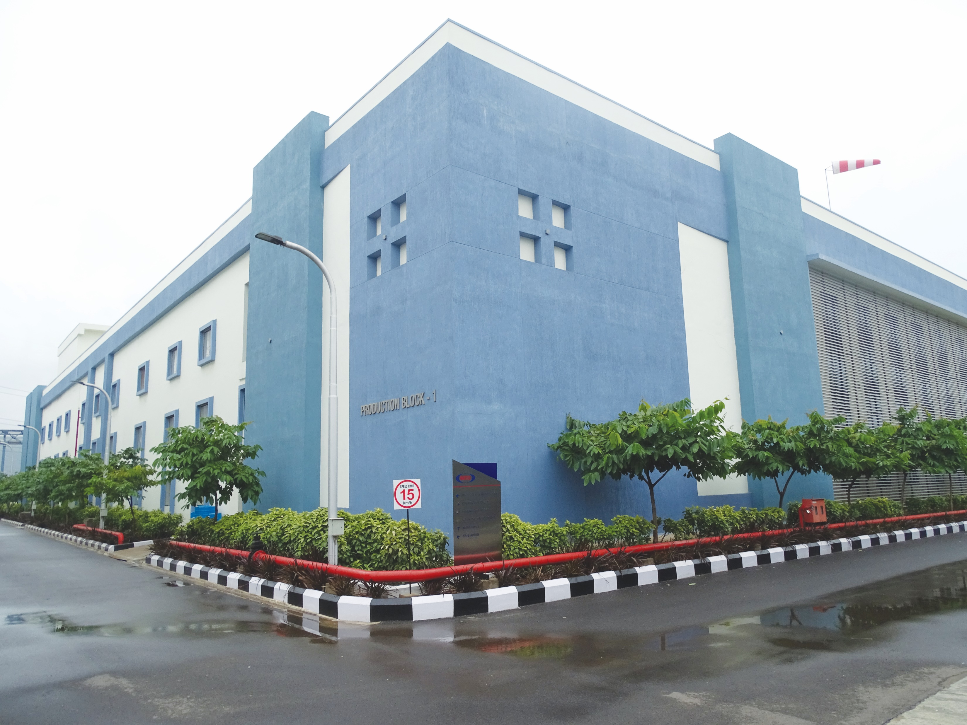
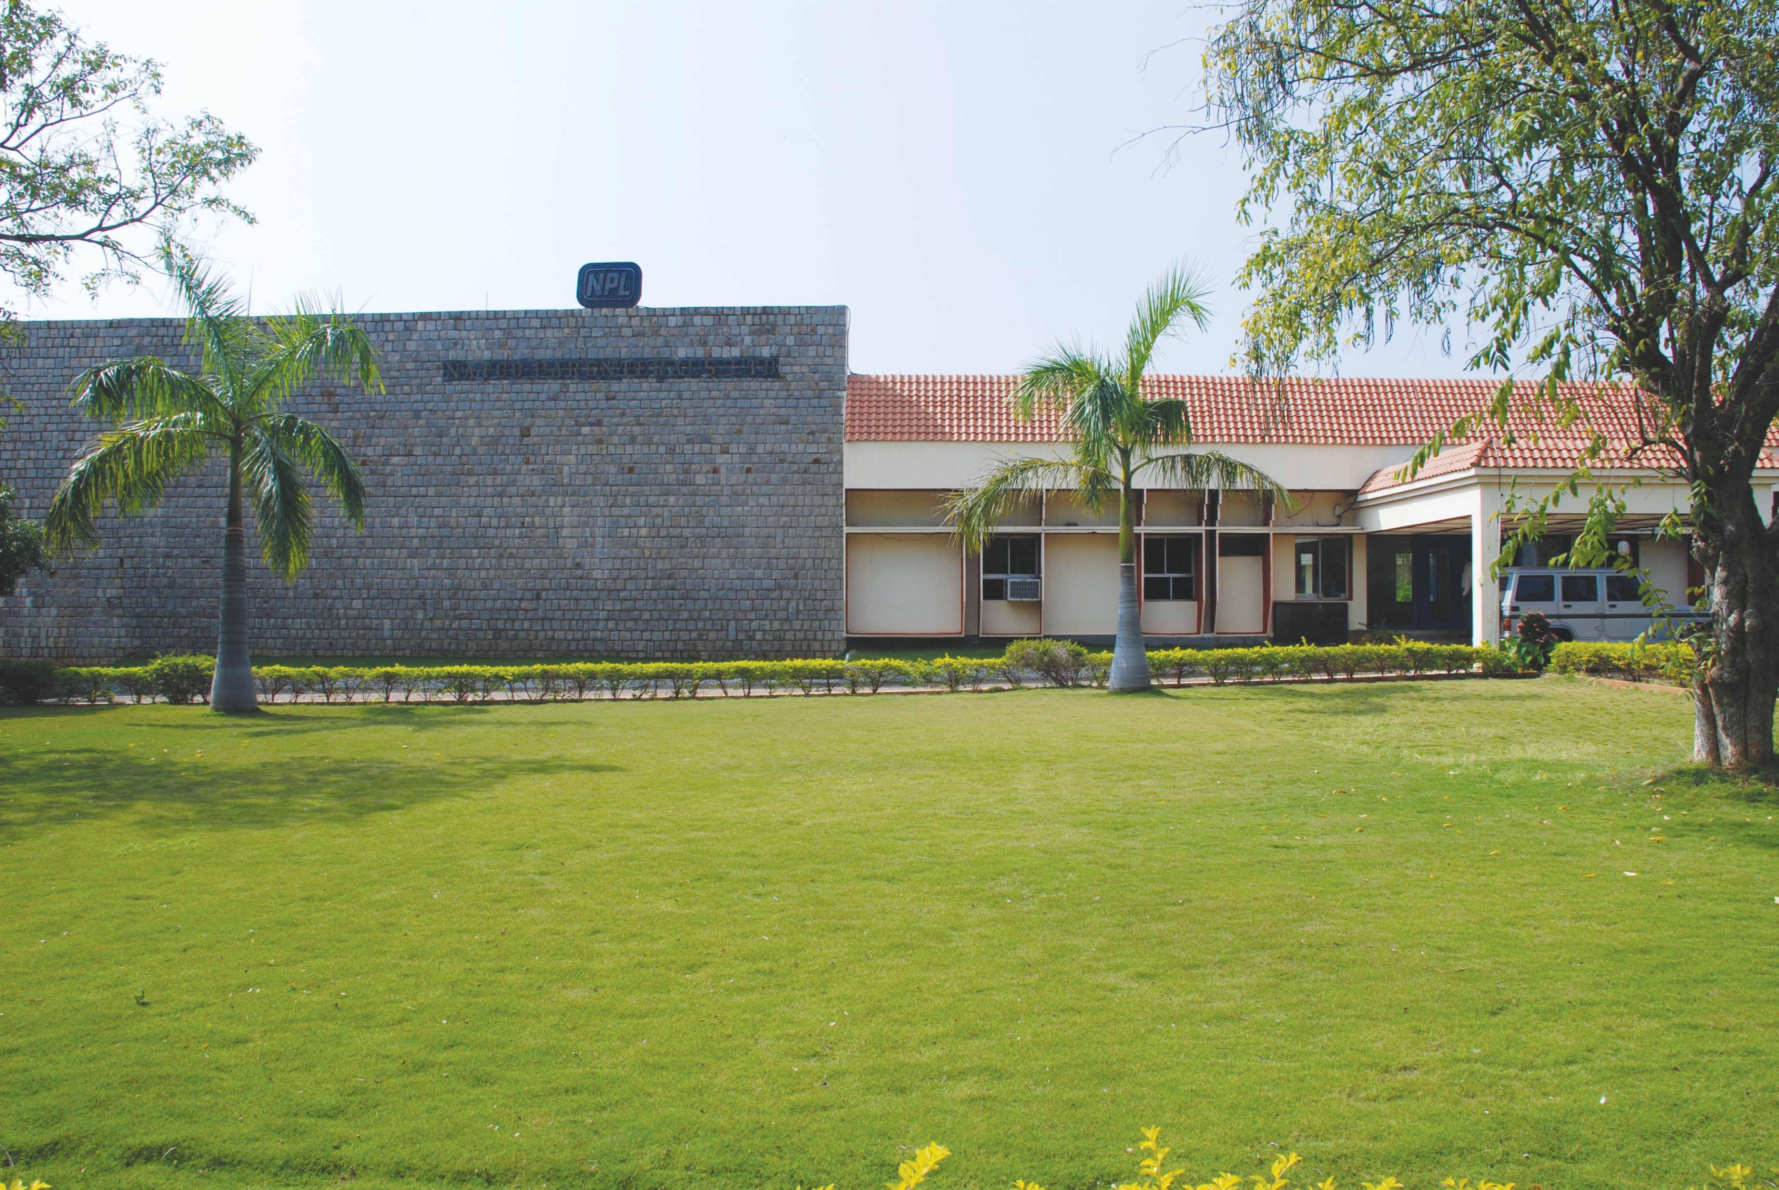
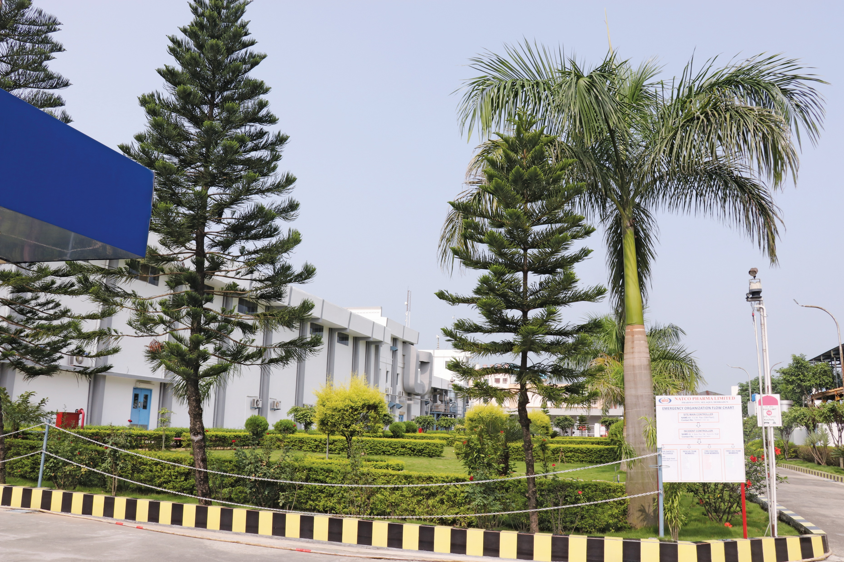
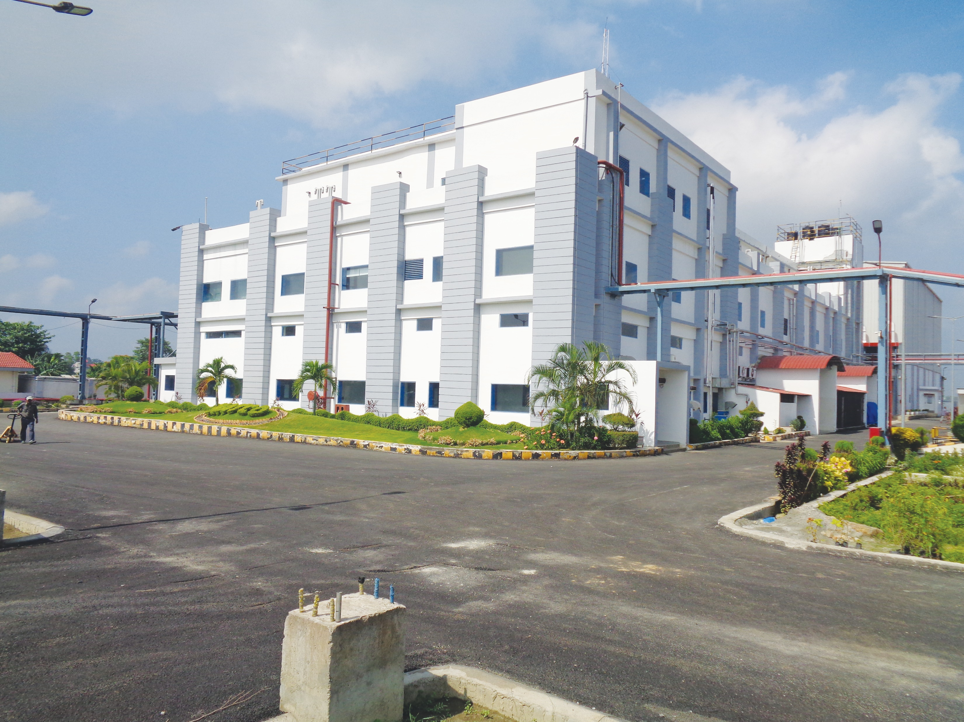
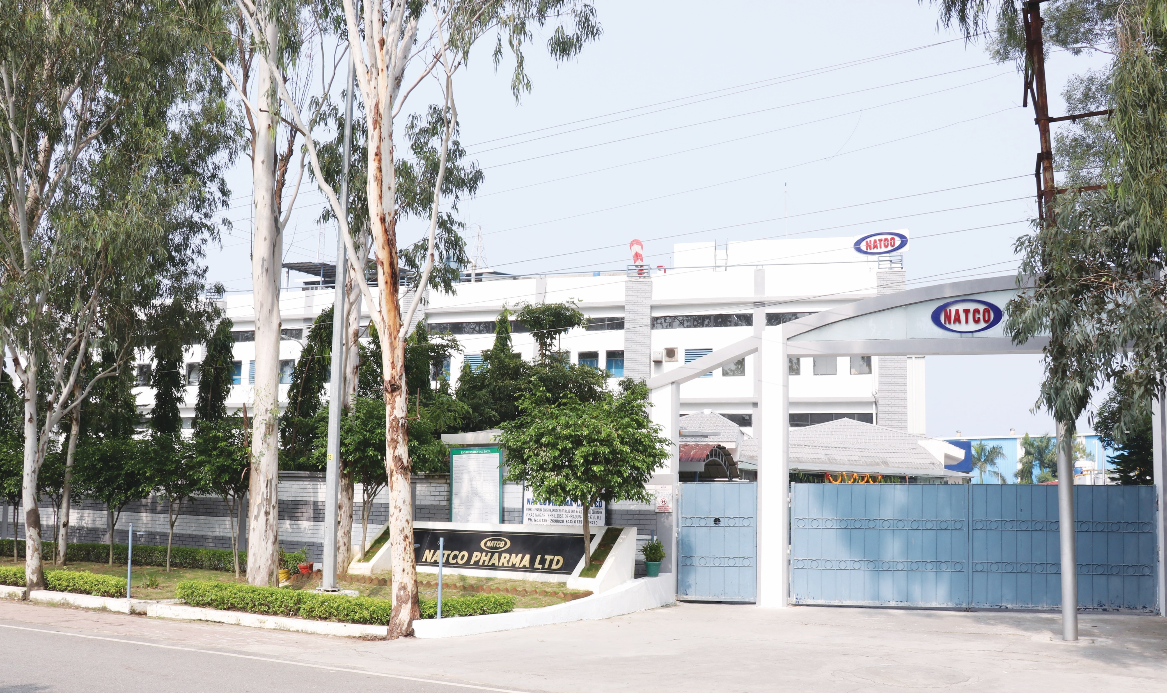
FORMULATION FACILITIES
INTERNATIONAL MARKETS
KOTHUR
Oral and solid dosages including cytotoxic Orals, cytotoxic injectables and pre-filled syringes
USFDA, GMP, (DCA), German, Health Authority, Australia TGA, ANVISA (Brazil)
USFDA audit with Establishment Inspection Report (EIR) received in August 2019
VISAKHAPATNAM
Solid oral tablet and capsule manufacturing
Site approval received from USFDA. First product approval of Chloroquine Phosphate
Targeted towards US & other International regulated markets
Located in a Special Economic Zone (SEZ)
DOMESTIC MARKETS
NAGARJUNA SAGAR
Oncology, Antibiotics and Antiviral
WHO GMP and Kenya MOH
DEHRADUN UNIT VI
Tablets, Capsules, Injectables
GMP
GUWAHATI
Tablets, Capsules
GMP Compliant facility
DEHRADUN UNIT VII
Tablets, Capsules
GMP, Public Health Service of the
Netherlands (EU GMP)

Slide 13
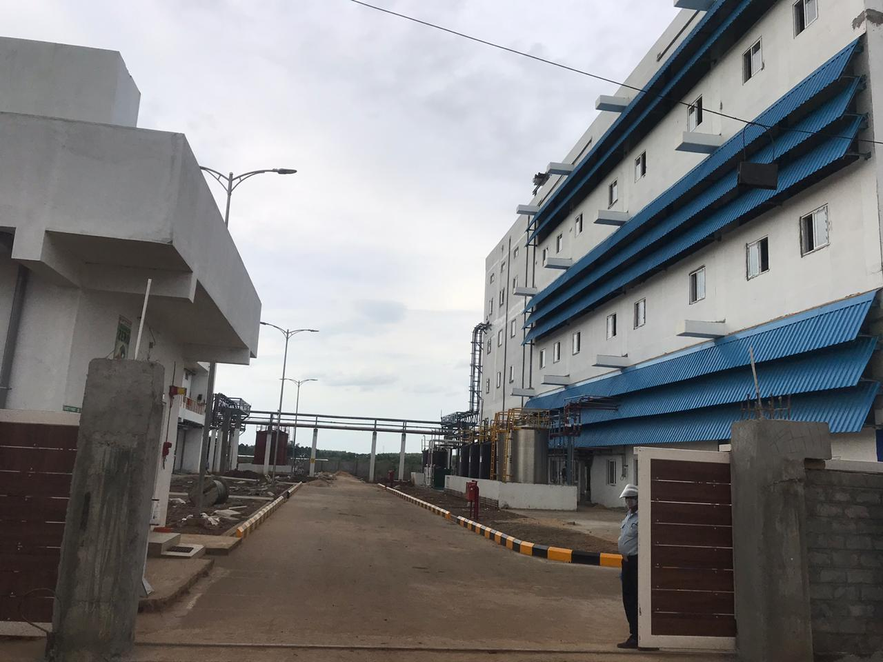
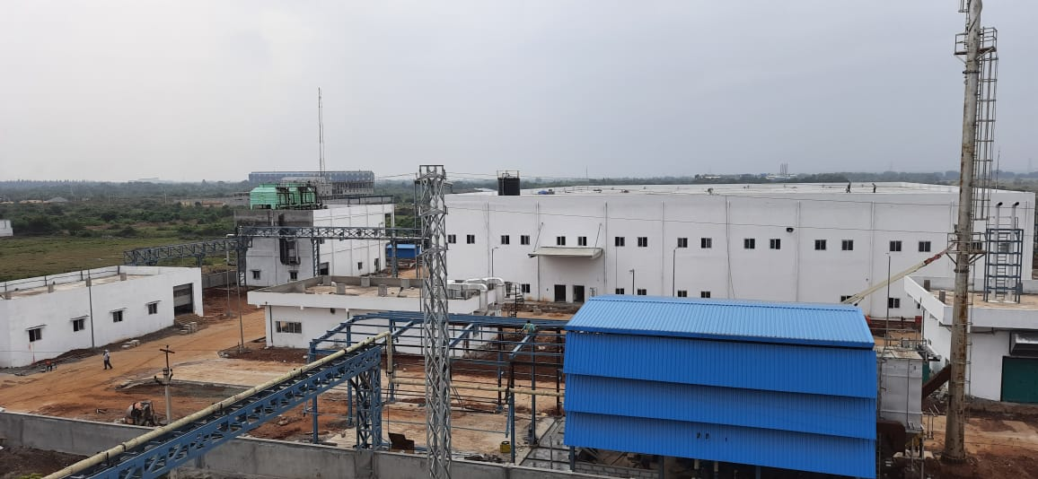
CROP HEALTH SCIENCES
TECHNICAL UNIT
Completed state-of-the-art greenfield manufacturing facilities for agro technical and formulation products, with a total Capex spend of approx. INR 152 crores
Acquired manufacturing assets for production of pheromone-based formulations, with technology transfer from ATGC
Targeting two categories of products – bioproducts and pesticides. Successfully launched first pheromone-based mating disruption product for management of Pink Bollworm pest in Kharif 2021 for cotton
Targeting other niche molecules in both product categories mentioned above during the current year
FORMULATION UNIT
PRODUCT PORTFOLIO
Agrochemicals
Bioproducts
Plant growth regulators
R&D
Development of new innovative molecules
Product testing lab near Hyderabad
Scaling up of manufacturing facilities for semio-chemicals at Shameerpet near Hyderabad
PRODUCT DEVELOPMENT
Field demonstration of newer chemistries
Farmer education and training about new products
Handling statutory needs and requirements

Slide 14
KEY MANAGEMENT
V.C Nannapaneni
Chairman and Managing Director
Holds a Masters degree in Pharmaceutical Administration from the Long Island University, USA
Over 4 decades of experience in the pharmaceutical industry
Rajeev Nannapaneni
Vice Chairman & CEO
Holds a Bachelors degree in Quantitative Economics and History from Tufts University, Boston, USA
Has over 20 years of experience in the pharmaceutical industry
P.S.R.K Prasad
Executive Vice President
(Corp. Engineering Services)
Holds a B.E. Mech. Engg. from Andhra University, Visakhapatnam
Responsible for looking after the general administration, engineering, regulatory, training, environmental matters, safety, health, production and maintenance activities of the Company
Dr. Linga Rao
President (Technical Affairs)
Holds a Masters degree in Science (Applied Chemistry) & Ph.D in Chemistry from JNTU, Hyderabad
Over 4 decades of experience in the pharmaceutical industry and has been working with Natco for 23+ years
M Adinarayana
Company Secretary,
Vice President-Legal Affairs
Bachelors in Commerce and Law from Andhra University, Fellow Member of Institute of Company Secretaries of India (ICSI)
Over 36 years of experience including 26 years with the Company in legal, secretarial, corporate affairs and patent litigation areas
S.V.V.N. Appa Rao
CFO
35+ years of experience including 26 years within the Company covering areas of accounting, finance, treasury, taxation
Responsible for finance and treasury functions at the Company
Dr. Pulla Reddy M
Executive Vice President - R&D
Holds Masters in Science (Chemistry) and Ph.D in Chemistry, both from University of Hyderabad. Did postdoctoral research for 2.5 years at University of Zurich, Switzerland
25+ years' experience at Natco with key role in developing novel commercially viable processes for over 100 APIs and intermediates
Dr. Rami Reddy B
Director - Formulations
Holds M. Pharm and Ph.D. (Pharmaceutics) degree from Nagpur University
33+ years of experience in the Pharmaceutical Formulation industry. Responsible for Formulation plant operations, Product development and Regulatory compliance
Rajesh Chebiyam
Executive Vice President, Crop Health Sciences
Holds an MBA from Babson College (USA) and a Masters degree in Chemical Engineering from University of Rhode Island
25+ years of experience across supply chain, operations, business development, sales and strategy
15

Slide 15
CONSOLIDATED FINANCIALS
Consolidated Profit & Loss Statement (₹ mn)
S.No. | Particulars | Year ended
 |  | 31 March 2021 | 31 March 2020
 | Income
1 | Revenue from operations | 20,521 | 19,150
2 | Other income | 1,036 | 1,074
3 | Total income (1+2) | 21,557 | 20,224
4 | Expenses
 | Cost of materials consumed | 3,729 | 3,290
 | Purchases of stock-in-trade | 1,866 | 1,278
 | Changes in inventories of finished goods, work-in-progress and stock-in-trade | (481) | (752)
 | Employee benefits expense | 4,149 | 3,750
 | Finance costs | 133 | 215
 | Depreciation and amortisation expense | 1,169 | 998
 | Other expenses | 5,196 | 5,758
 | Total expenses | 15,761 | 14,537
5 | Profit before exceptional items and tax (3-4) | 5,796 | 5,687
6 | Exceptional items | - | -
7 | Profit before tax (5-6) | 5,796 | 5,687
8 | Tax expense
 | (i) Current tax | 1,408 | 1,271
 | (ii) Income-tax for earlier years | 70 | 40
 | (iii) Deferred tax charge /(credit) | (106) | (205)
 | Total tax expense | 1,372 | 1,106
9 | Profit for the period/year (7-8) | 4,424 | 4,581
10 | Other comprehensive income (net of tax)
 | A. Items that will not be reclassified subsequently to profit or loss:
 | Remeasurement of defined benefit plans | (8) | (79)
 | Net gains / (losses) from investments in equity instruments designated at Fair value through other comprehensive income (FVTOCI) | 143 | (20)
 | Income-tax relating to items that will not be reclassified to profit or loss | (10) | 34
 | B. Items that will be reclassified subsequently to profit or loss:
 | Exchange differences on translation of foreign operations | (38) | (80)
 |  | (38) | (80)
 | Total other comprehensive income (net of tax) (A+B) | 87 | (145)
11 | Total comprehensive income for the period/ year (9+10) | 4,511 | 4,436
12 | Profit for the period/year attributable to:
 | Owners of the Company | 4,409 | 4,608
 | Non-controlling interests* | 15 | (27)
13 | Other comprehensive income attributable to:
 | Owners of the Company | 87 | (145)
 | Non-controlling interests | - | -
14 | Total comprehensive income attributable to:
 | Owners of the Company | 4,496 | 4,463
 | Non-controlling interests* | 15 | (27)
15 | Paid-up equity share capital (face value of ₹2 each) | 365 | 364
16 | Other equity | 40,851 | 37,371
17 | Earnings per share (face value ₹2 each)
 | Basic (in ₹) | 24.20 | 25.33
 | Diluted (in ₹) | 24.16 | 25.26
Consolidated Balance Sheet (₹ mn)
 |  | 31 March 2021 | 31 March 2020
I | Assets
(1) | Non-current assets
 | (a) Property, plant and equipment | 20,138 | 15,756
 | (b) Capital work-in-progress | 2,234 | 5,180
 | (c) Intangible assets | 94 | 88
 | (d) Financial assets
 | (i) Investments | 1,594 | 836
 | (ii) Loans | 158 | 161
 | (iii) Other financial assets | 43 | 42
 | (e) Other non-current assets | 285 | 559
 | Total non-current assets | 24,546 | 22,622
(2) | Current assets
 | (a) Inventories | 7,982 | 5,580
 | (b) Financial assets
 | (i) Investments | 1,443 | 287
 | (ii) Trade receivables | 4,129 | 5,513
 | (iii) Cash and cash equivalents | 258 | 198
 | (iv) Bank balances other than (iii) above | 2,577 | 462
 | (v) Loans | 131 | 84
 | (vi) Other financial assets | 4,270 | 8,588
 | (c) Other current assets | 2,583 | 2,544
 | Total current assets | 23,373 | 23,256
 | Total assets | 47,919 | 45,878
II | EQUITY AND LIABILITIES
(1) | Equity
 | (a) Equity share capital | 365 | 364
 | (b) Other equity | 40,851 | 37,371
 | Equity attributable to owners of the Company | 41,216 | 37,735
 | (c) Non-controlling interest | 18 | 112
 | Total equity | 41,234 | 37,847
(2) | Liabilities
 | (A) Non-current liabilities
 | (a) Financial liabilities
 | (i) Borrowings | 9 | 9
 | (ii) Other financial liabilities | 11 | 8
 | (b) Provisions | 996 | 902
 | (c) Deferred tax liabilities, net | 413 | 259
 | Total non-current liabilities | 1,429 | 1,178
 | (B) Current liabilities
 | (a) Financial liabilities
 | (i) Borrowings | 2,667 | 3,150
 | (ii) Trade payables
 | - Dues of micro and small enterprises | 75 | 21
 | - Dues of creditors other than micro and small enterprises | 1,387 | 2,533
 | (iii) Other financial liabilities | 864 | 825
 | (b) Other current liabilities | 122 | 134
 | (c) Provisions | 128 | 105
 | (d) Current tax liabilities, net | 13 | 85
 | Total current liabilities | 5,256 | 6,853
 | Total liabilities | 6,685 | 8,031
 | Total equity and liabilities | 47,919 | 45,878

Slide 16
QUARTERLY FINANCIAL SUMMARY
SEGMENTAL BREAKDOWN (₹ mn)
Revenue Division | Q1FY22 | Q1FY21 | FY21 | FY20
A) API Revenue⁽¹⁾:- | 616 | 1,439 | 5,120 | 3,552
B) Formulation:-
B1) Formulation export, profit share, export service income & revenue from Subsidiaries | 1,454 | 2,743 | 10,771 | 9,334
B2) Domestic Formulation:- | 2,006 | 1,256 | 4,101 | 5,405
Formulations Total Revenue (B1+B2) | 3,460 | 3,999 | 14,873 | 14,739
C) Crop Health Sciences | 6 | - | 21 | -
D) Other Operating & Non - operating incomes | 192 | 383 | 1,543 | 1,933
Consolidated Total Revenue | 4,273 | 5,821 | 21,557 | 20,224
CONSOLIDATED FINANCIAL RESULTS (₹ mn)
 | Q1FY22 | Q1FY21 | FY21 | FY20
Total Revenues | 4,273 | 5,821 | 21,557 | 20,224
EBITDA | 1,268 | 1,898 | 7,098 | 6,900
EBITDA Margin (%) | 29.7% | 32.6% | 32.9% | 34.1%
PAT (after minority interest) | 750 | 1,228 | 4,409 | 4,608
PAT Margin (%) | 17.6% | 21.1% | 20.5% | 22.8%
(1) Revenue regrouped to include API trading income

Slide 17
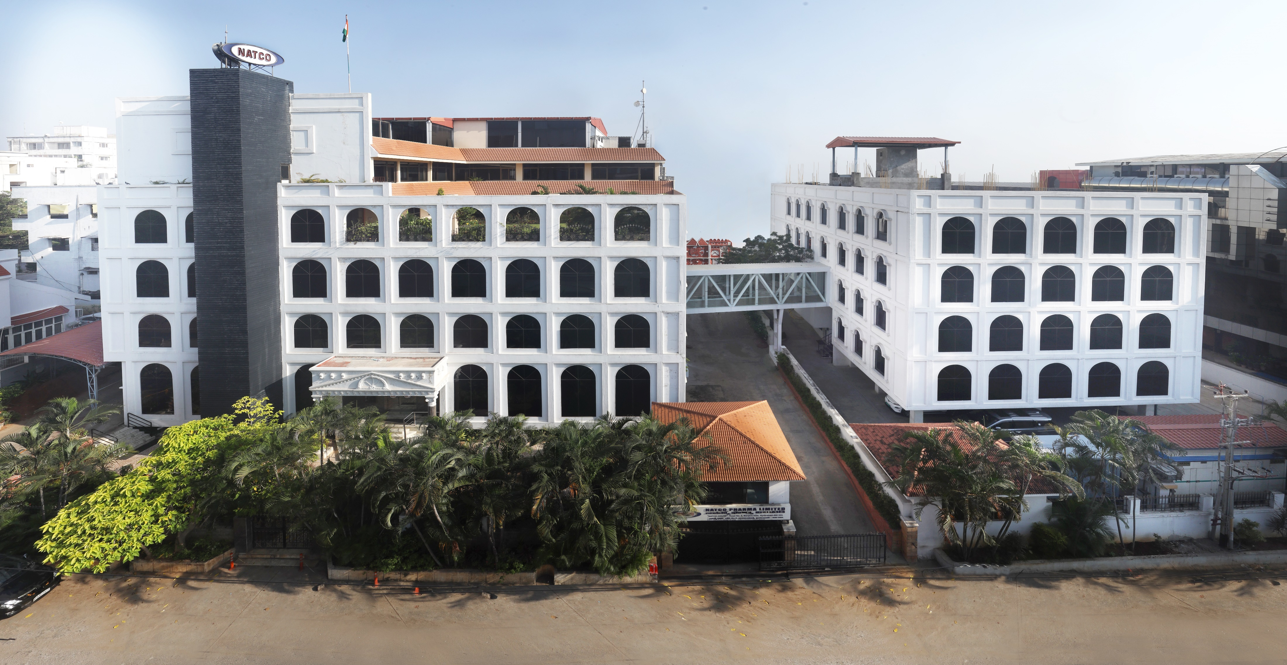
Contact Investor Relations Team at
ir@natcopharma.co.in
040-2354 7532; Extn 220
A VIEW OF NATCO’S CORPORATE OFFICE

